Slide 1
LAB 9 Data Parallelism
Notes:
NOTE: Each lab will need 14 sets of crayons and 56 grid papers

Slide 2

STEP 1: Pre-Activity Quiz to Assess Pre-Knowledge
Please take this pre-lab quiz: https://tntech.co1.qualtrics.com/jfe/form/SV_6FOZTkL5803yj6S

Slide 3

STEP TWO: FlagMaker Activity
You’ll be pretending to be the computer drawing the flag of Mauritius (on the right).
You’ll use paper and markers
Follow how a computer might draw it as if each box were an element in an array and the computer is iterating through the array in order.
You must fill in the squares and color one square at a time (do not color in multiple squares at one time).
Img from: https://en.wikipedia.org/wiki/Mauritius
1 | 2 | 3 | 4 | 5 | 6 | 7 | 8
9 | 10 | 11 | 12 | 13 | 14 | 15 | 16
17 | 18 | 19 | 20 | 21 | 22 | 23 | 24
25 | 26 | 27 | 28 | 29 | 30 | 31 | 32
33 | 34 | 35 | 36 | 37 | 38 | 39 | 40
41 | 42 | 43 | 44 | 45 | 46 | 47 | 48
49 | 50 | 51 | 52 | 53 | 54 | 55 | 56
57 | 58 | 59 | 60 | 61 | 62 | 63 | 64

Slide 4

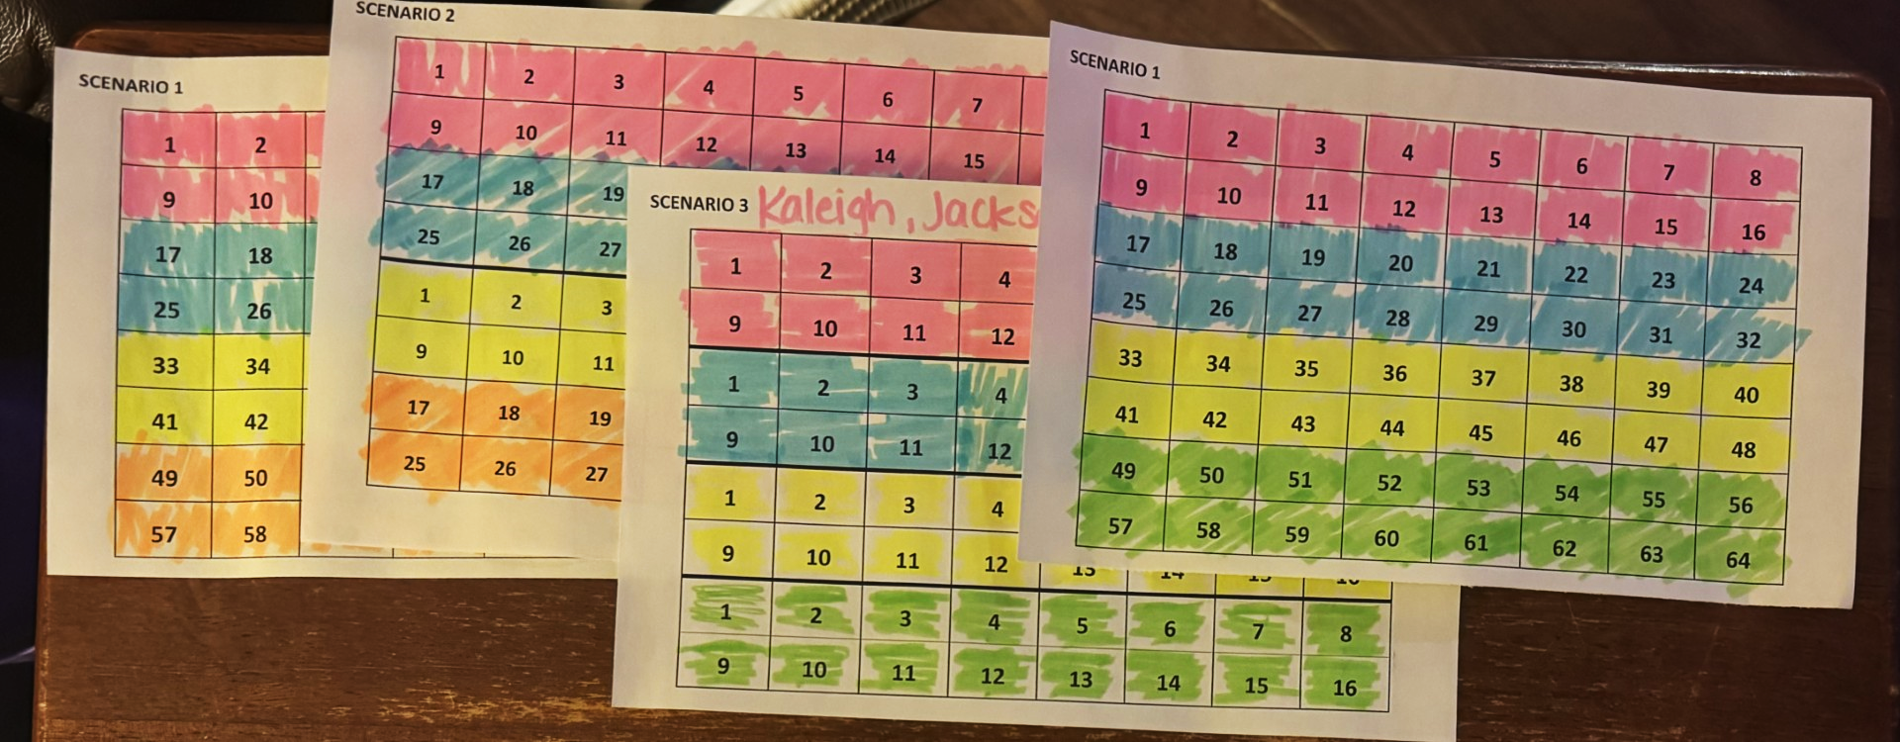

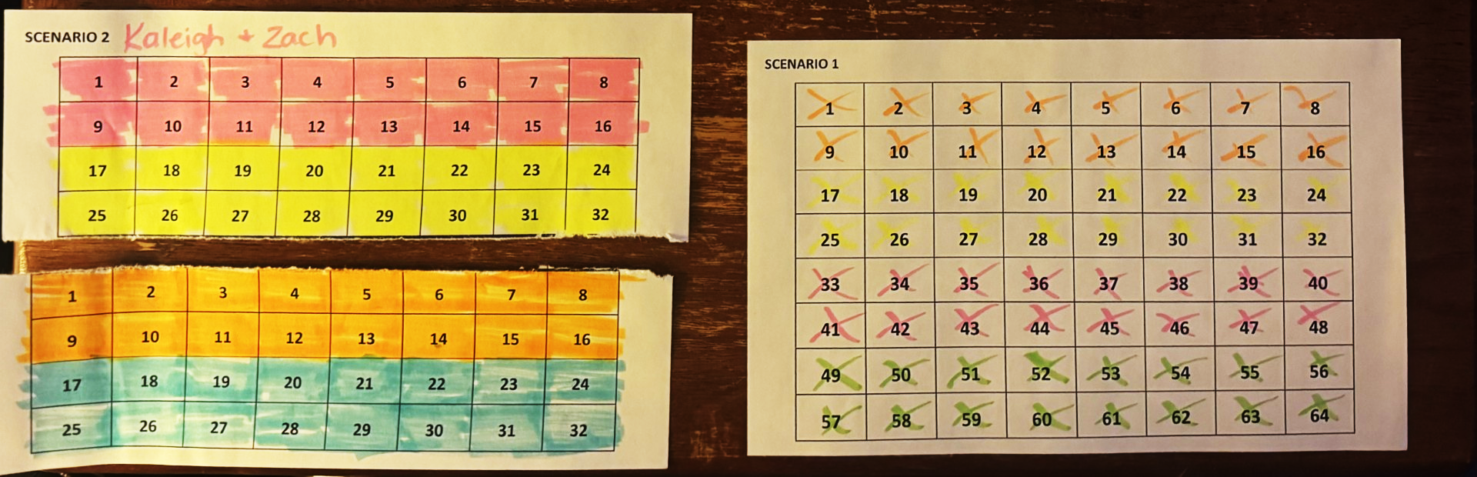
FlagMaker Activity
CORRECT!
You must color one square at a time.
Do not color in multiple squares at one time.
WRONG!
Fill in the squares
WRONG!
Don’t tear the paper!

Slide 5
Scenario 1: A Single Processor
Two people:
The Processor: colors first stripe (box by box), second stripe (box by box), third stripe (box by box), and then fourth stripe (box by box)
Timer: Times the Processor
P1 | 1 | 2 | 3 | 4 | 5 | 6 | 7 | 8
 | 9 | 10 | 11 | 12 | 13 | 14 | 15 | 16
 | 17 | 18 | 19 | 20 | 21 | 22 | 23 | 24
 | 25 | 26 | 27 | 28 | 29 | 30 | 31 | 32
 | 33 | 34 | 35 | 36 | 37 | 38 | 39 | 40
 | 41 | 42 | 43 | 44 | 45 | 46 | 47 | 48
 | 49 | 50 | 51 | 52 | 53 | 54 | 55 | 56
 | 57 | 58 | 59 | 60 | 61 | 62 | 63 | 64
Remember: squares must be mostly colored in & you can only color one square at a time!
Notes:
28 students / 2 = 14 scenario 1 pages per lab * 10 labs = 140 (2 per page so 70 copies)

Slide 6
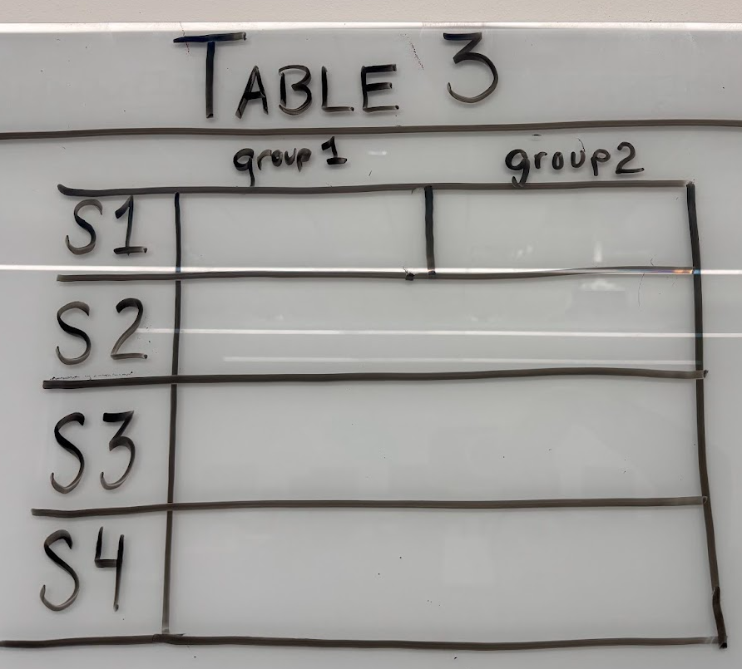
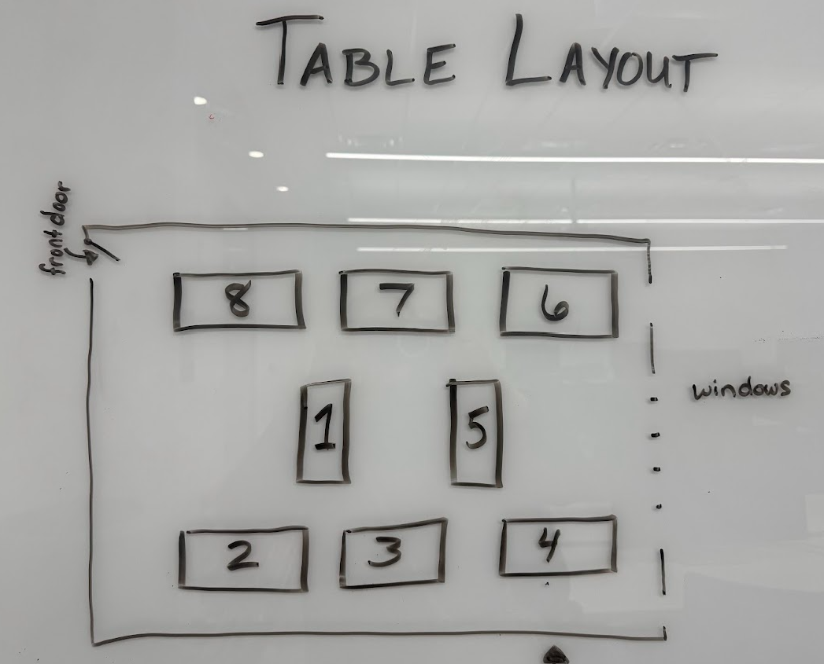
Scenario 1: Record your Times on the Whiteboard!
Put your group’s time in the scenario 1 row.
Identify your table number on one of the white boards.
Notes:
Question 1: Why does this process take a long time with only one "processor"? Answer: With only one processor, every action is sequential, meaning each cell has to be processed one at a time without any parallel work. This highlights the limitations of a single-threaded system where tasks cannot be divided to reduce time, demonstrating the concept of processing bottlenecks.
Question 2: How could this approach cause inefficiency in more complex tasks? Answer: In complex tasks requiring a lot of data handling, using a single processor would result in slow performance as it processes each item individually. This scenario illustrates that while accurate, sequential processing is not scalable for tasks requiring high efficiency and speed.

Slide 7
Scenario 1: A Single Processor Let’s Talk About It
With only one processor, every action is sequential, meaning each cell must be processed one at a time without any parallel work.
This highlights the limit of a single-processor system where tasks cannot be divided to reduce time, demonstrating the concept of processing bottlenecks.
In complex tasks requiring a lot of data handling, using a single processor would result in slow performance as it processes each item individually.
Notes:
Question 1: Why does this process take a long time with only one "processor"? Answer: With only one processor, every action is sequential, meaning each cell has to be processed one at a time without any parallel work. This highlights the limitations of a single-threaded system where tasks cannot be divided to reduce time, demonstrating the concept of processing bottlenecks.
Question 2: How could this approach cause inefficiency in more complex tasks? Answer: In complex tasks requiring a lot of data handling, using a single processor would result in slow performance as it processes each item individually. This scenario illustrates that while accurate, sequential processing is not scalable for tasks requiring high efficiency and speed.

Slide 8
Scenario 2: Two Processors Collaborating
P1 | 1 | 2 | 3 | 4 | 5 | 6 | 7 | 8
 | 9 | 10 | 11 | 12 | 13 | 14 | 15 | 16
 | 17 | 18 | 19 | 20 | 21 | 22 | 23 | 24
 | 25 | 26 | 27 | 28 | 29 | 30 | 31 | 32
P2 | 1 | 2 | 3 | 4 | 5 | 6 | 7 | 8
 | 9 | 10 | 11 | 12 | 13 | 14 | 15 | 16
 | 17 | 18 | 19 | 20 | 21 | 22 | 23 | 24
 | 25 | 26 | 27 | 28 | 29 | 30 | 31 | 32
Three people:
Processor 1: Colors red and blue stripes (cell by cell)
Processor 2: Colors yellow and green stripes (cell by cell)
Timer: Times them; stop when all cells are colored.
Remember: squares must be mostly colored in & you can only color one square at a time!
Notes:
28 students / 3 = ~10 scenario 2 pages per lab * 10 labs = 100 (2 per page so 50 copies)

Slide 9
Scenario 2: Record your Times on the Whiteboard!
Put your group’s time in the scenario 2 row.
Notes:
Question 1: Why does this process take a long time with only one "processor"? Answer: With only one processor, every action is sequential, meaning each cell has to be processed one at a time without any parallel work. This highlights the limitations of a single-threaded system where tasks cannot be divided to reduce time, demonstrating the concept of processing bottlenecks.
Question 2: How could this approach cause inefficiency in more complex tasks? Answer: In complex tasks requiring a lot of data handling, using a single processor would result in slow performance as it processes each item individually. This scenario illustrates that while accurate, sequential processing is not scalable for tasks requiring high efficiency and speed.

Slide 10
Scenario 2: Two Processors Collaborating Let’s Talk About It
Compare your times for Scenario 1 vs. Scenario 2. Was it faster?
Adding a second processor allows for parallel processing, so two stripes of the flag can be worked on simultaneously, cutting down completion time. This demonstrates how distributing tasks between processors can increase efficiency and speedup. Speedup is the ratio of the time taken to solve a problem on a single processor to the time taken on a parallel system.
A programmer can increase performance by using more processors.
Scalability refers to the ability of a system to increase its performance proportionally with the addition of more processors.
Notes:
Question 1: How does the addition of a second processor impact the overall completion time? Answer: Adding a second processor allows for parallel processing, so two stripes (red and blue, yellow and green) can be worked on simultaneously, effectively cutting down the completion time. This demonstrates how distributing tasks between processors can increase efficiency.
Question 2: What potential problems could arise if both processors were given overlapping tasks? Answer: If both processors colored the same stripes, they might overwrite each other’s work, causing inconsistencies. This introduces the concept of race conditions, where two processes access and modify shared data at the same time, leading to unpredictable results.

Slide 11
Scenario 3: Four Processors Collaborating
P1 | 1 | 2 | 3 | 4 | 5 | 6 | 7 | 8
 | 9 | 10 | 11 | 12 | 13 | 14 | 15 | 16
P2 | 1 | 2 | 3 | 4 | 5 | 6 | 7 | 8
 | 9 | 10 | 11 | 12 | 13 | 14 | 15 | 16
P3 | 1 | 2 | 3 | 4 | 5 | 6 | 7 | 8
 | 9 | 10 | 11 | 12 | 13 | 14 | 15 | 16
P4 | 1 | 2 | 3 | 4 | 5 | 6 | 7 | 8
 | 9 | 10 | 11 | 12 | 13 | 14 | 15 | 16
Five people:
Processors 1-4: Each assigned to one color, which they color (cell by cell)
Timer: Times them; stop when all cells are colored.
Remember: squares must be mostly colored in & you can only color one square at a time!
Notes:
28 students / 4 = 7 scenario 3 pages per lab * 10 labs = 70 (2 per page so 35 copies)

Slide 12
Scenario 3: Record your Times on the Whiteboard!
Put your group’s time in the scenario 3 row.

Slide 13
Scenario 3: Four Processors Collaborating Let’s Talk About It
Four processors allow each to work on one color stripe independently, speeds up the work even more!
However, with more processors, synchronization becomes crucial to ensure they don’t interfere with each other’s work.
If one processor finishes early, it sits idle, which is an example of underutilized resources.
In real systems, load balancing is essential to ensure each processor has roughly the same amount of work to prevent idle time.
Notes:
Question 1: How does using four processors further improve efficiency, and what challenges might this bring? Answer: Four processors allow each to work on one color stripe independently, reducing the time needed even more than with two processors. However, with more processors, synchronization becomes crucial to ensure they don’t interfere with each other’s work, which can lead to increased coordination complexity.
Question 2: What would happen if one processor finished its task significantly earlier than the others? Answer: If one processor finishes early, it sits idle, which is an example of underutilized resources. In real systems, load balancing is essential to ensure all processors have tasks of roughly equal duration to maximize efficiency.

Slide 14
Scenario 4: Four Processors Collaborating a Different Way (Column Assignments)
P1 |  | P2 |  | P3 |  | P4
1 | 9 | 1 | 9 | 1 | 9 | 1 | 9
2 | 10 | 2 | 10 | 2 | 10 | 2 | 10
3 | 11 | 3 | 11 | 3 | 11 | 3 | 11
4 | 12 | 4 | 12 | 4 | 12 | 4 | 12
5 | 13 | 5 | 13 | 5 | 13 | 5 | 13
6 | 14 | 6 | 14 | 6 | 14 | 6 | 14
7 | 15 | 7 | 15 | 7 | 15 | 7 | 15
8 | 16 | 8 | 16 | 8 | 16 | 8 | 16
Five people:
Processors 1-4: Each assigned a strip of two columns (first takes left 2 columns, second takes next two columns, etc.) Processors colors these the correct color cell by cell.
Timer: Times them; stop when all cells are colored.
Remember: squares must be mostly colored in & you can only color one square at a time!
Notes:
28 students / 4 = 7 scenario 3 pages per lab * 10 labs = 70 (2 per page so 35 copies)

Slide 15
Scenario 4: Record your Times on the Whiteboard!
Put your group’s time in the scenario 4 row.
Notes:
Question 1: Why does this process take a long time with only one "processor"? Answer: With only one processor, every action is sequential, meaning each cell has to be processed one at a time without any parallel work. This highlights the limitations of a single-threaded system where tasks cannot be divided to reduce time, demonstrating the concept of processing bottlenecks.
Question 2: How could this approach cause inefficiency in more complex tasks? Answer: In complex tasks requiring a lot of data handling, using a single processor would result in slow performance as it processes each item individually. This scenario illustrates that while accurate, sequential processing is not scalable for tasks requiring high efficiency and speed.

Slide 16
Scenario 4: Four Processors Collaborating a Different Way (Column Assignments) Let’s Talk About It
Was it slower or faster?
Did each person (processor) use a marker, and then pass it to the next person to use – over and over until the work was done? This is called pipelining – the technique of overlapping the execution of multiple instructions to improve performance.
Was each person (processor) sometimes waiting for a marker? When multiple processors are waiting on (competing for) shared resources, this is called contention. Processors might risk stepping into each other’s workspaces at the boundaries, which can lead to race conditions unless clearly separated. A race condition is a computer error where multiple processors try to access or modify shared data simultaneously.
Notes:
Question 1: How does assigning processors by columns rather than stripes impact performance and potential errors? Answer: This column-based approach lets each processor work on sections across all colors, which might improve efficiency if coloring large sections by color becomes too complex. However, with this setup, processors might again risk stepping into each other’s workspaces at the boundaries, which can lead to race conditions unless clearly separated.
Question 2: How does this scenario reflect real-world issues in distributed systems? Answer: Distributed systems often allocate resources by dividing tasks spatially, just as columns are divided here. However, managing boundaries is crucial to prevent overlaps and race conditions, which require robust coordination protocols in real-world systems to ensure data integrity.

Slide 17

STEP 3: Post-Activity Quiz & Survey
Please take this post-lab quiz/survey: https://tntech.co1.qualtrics.com/jfe/form/SV_0pl4GIxbU7CiJqC

Slide 18

Lab 9 - Sequential vs. Parallel Programming
Download Lab 9 Assignment from ilearn

